Slide 1
Optimal level of Cash
BUAN 5270
Mohan Chamakuri, Quang Dang, Yada So,
Zaid Syed, Evangeline Yang

Slide 2

Introduction
For managing future firm performance and stock returns.
Small Corporations vs. Large Corporations (e.g., Apple)
Examples like Pandemic Impact: Needs for sufficient cash to sustain business operations. (e.g., WeWork)
Balance Key: Ensuring liquidity for immediate needs while planning strategic growth.
Notes:
Small corp: Essential for operational fluidity, especially during financial crises.
Big Corp: Balancing between holding cash for long-term plans and avoiding underutilized resources.

Slide 3
1. WHAT IS THE OPTIMAL LEVEL OF CASH?
WHY IS IT IMPORTANT?
Optimal Cash Level: Balance where a firm's Marginal benefits of holding additional cash are equal to marginal costs.
Importance: For future firm performance and stock return.
Risk of Deviation: Excess and insufficient cash negatively impact future performance.
Managing Liquidity: Vital for meeting operational needs and making investments.
Avoiding Negative Impacts: Excessive cash lead to reduced investment returns and inefficient capital allocation.
RNOA Impact: Optimal Cash Level is important for maintaining healthy RNOA, indicating efficient asset utilization and profitability.

Slide 4
Today’s Topics
1. WHAT IS THE OPTIMAL LEVEL OF CASH? 2. DATA PRE-PROCESSING 3. DATA EXPLORATION 4. RESULTS OF REGRESSION ANALYSIS 5. RECOMMENDATIONS

Slide 5

2. DATA PRE-PROCESSING
How we Pull the Data:
Follow the steps which professor showed us in class.
Go to https://wrds-www.wharton.upenn.edu/
Log in to your account
Choose Compustat – Capital IQ => North America => Fundamentals Annual
Set the date from 1951-01 to 2022-12
In the "Apply your company code" section, choose [Search the entire database]
Next, choose your desired variables that you need to do your work
Select the query output format as *.sas7bdat
And the date format as YYYYMMDD
Then click [Submit form]
After your data is ready, download and Let's go.

Slide 6
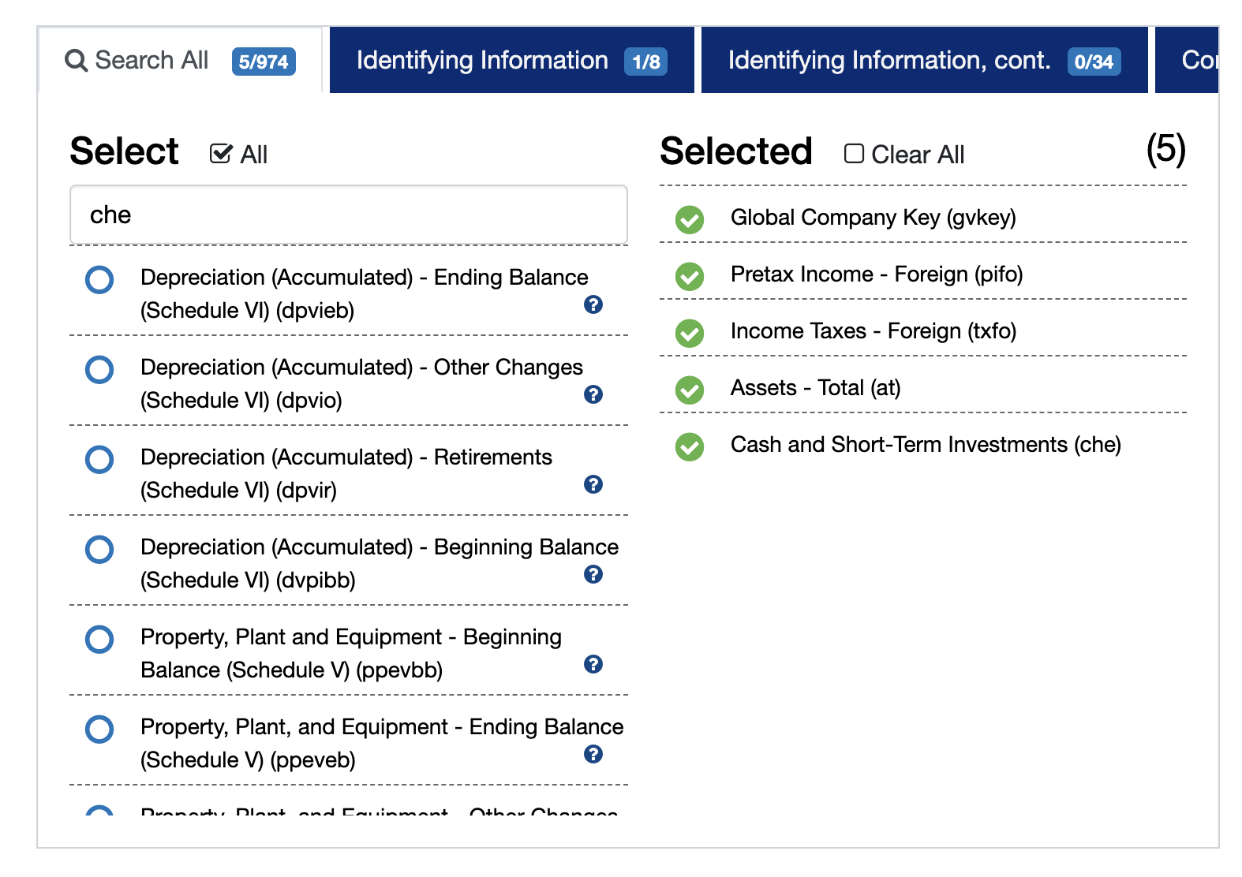
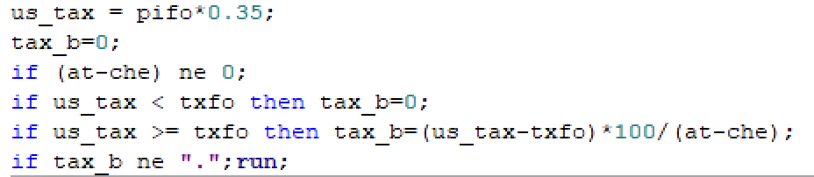
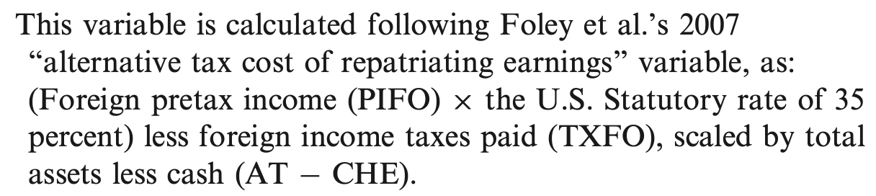
2. DATA PRE-PROCESSING
Example: pulling data to calculate [Tax Burden and Foreign Income]

Slide 7
2. DATA PRE-PROCESSING
Remove missing value
Getting data from 1987 to 2020
Remove companies with stock prices less than 2$
Exclude companies in the utilities and financial industry
How we Clean the Data:

Slide 8
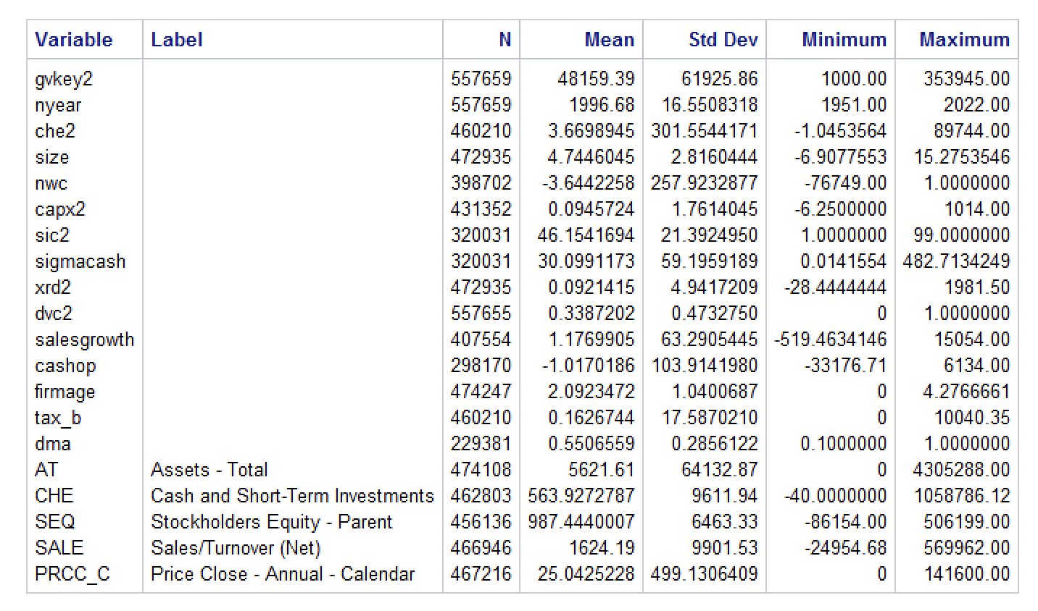
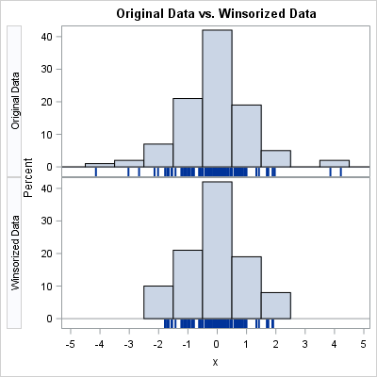
2. DATA PRE-PROCESSING
Merge the data and Remove the outliers:
Remove the outliers

Slide 9
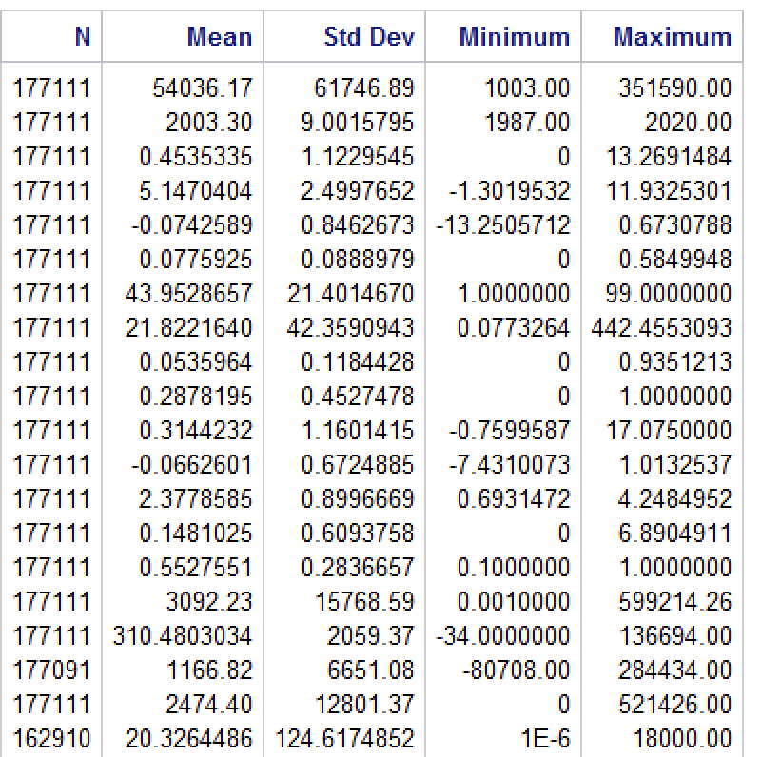
2. DATA PRE-PROCESSING
Winsorization makes the classical statistics more robust by reducing the impact of extreme observations.
Before
After

Slide 10

Table 1 (DESCRIPTIVE Statistics)
3. Data Exploration
Variable | N | Mean | Std. Deviation | 25th. Percentile | Median | 75^{th.} Percentile
Cash Level | 116099 | 0.483 | 1.146 | 0.030 | 0.118 | 0.394
Firm size | 116099 | 5.773 | 2.123 | 4.235 | 5.646 | 7.215
Net Working Capital | 116099 | 0.064 | 0.406 | -0.036 | 0.086 | 0.239
Capital Expenditure | 116099 | 0.078 | 0.084 | 0.026 | 0.050 | 0.096
Industry Sigma | 116099 | 20.119 | 39.116 | 1.710 | 5.624 | 17.012
R&D | 116099 | 0.047 | 0.094 | 0.000 | 0.002 | 0.057
Dividend Dummy | 116099 | 0.358 | 0.479 | 0.000 | 0.000 | 1.000
Sales growth | 116099 | 0.287 | 0.984 | -0.008 | 0.097 | 0.272
Cash from Operation | 116099 | 0.018 | 0.500 | 0.020 | 0.090 | 0.160
Firm age | 116099 | 2.502 | 0.894 | 1.791 | 2.564 | 3.218
Tax burden on Foreign Income | 116099 | 0.193 | 0.685 | 0.000 | 0.000 | 0.000
Management Ability | 116099 | 0.553 | 0.286 | 0.300 | 0.600 | 0.800

Slide 11

TABLE 2 (correlation)
 | Firm Size | Net Working Capital | Capital Expenditure | Industry Sigma | Research & Development | Dividend Dummy | Sales Growth | Cash from Operation | Firm Age | Tax Burden | Management Ability
Cash Level | -0.15434 <.0001 | -0.26604 <.001 | 0.13025 <.0001 | 0.09282 <.0001 | 0.33456 <.0001 | -0.15578 <.0001 | 0.14021 <.0001 | -0.46133 <.0001 | -0.16195 <.0001 | 0.03020 <.0001 | 0.01576 <.0001
Cash is negatively correlated with firm size, net working capital, dividend dummy, cash from operations, and firm age.;
Cash is positively correlated with capital expenditure, industry sigma, R&D, sales growth, tax burden, and managerial ability.
We didn’t drop any variable because there is no high correlation between our variables.

Slide 12
4. Regression Analysis
Variable | Oler et al. model |  | Our model
Variable | Estimate | Pr > |t| | Estimate | Pr > |t|
Firm Size | -0.061 | <0.001 | -0.041 | <0.001
Net Working Capital | -1.579 | <0.001 | -0.765 | <0.001
Cash from Operations | -1.017 | <0.001 | -0.816 | <0.001
Firm Age | -0.091 | <0.001 | -0.088 | <0.001
Capital Expenditures | 1.525 | <0.001 | 1.541 | <0.001
Industry Sigma | 0.202 | <0.001 | 0.001 | <0.001
R&D | 0.109 | 0.264 | 0.341 | <0.001
Sales Growth | 0.058 | <0.001 | 0.053 | <0.001
Tax Burden on Foreign Income | 0.092 | <0.001 | 0.066 | <0.001
Dividend Dummy | 0.026 | <0.001 | -0.036 | <0.001
Managerial Ability |  |  | 0.296 | <0.001
Intercept | 1.388 |  | 0.483 | <0.001
No. of Observations | 64,603 |  | 116,099
F-Score | 663.04 | <0.001 | 1011.74 | <0.001
Adjusted R-squared | 48.3% |  | 46.54%

Slide 13
5. recommendations
Cash ↑ with high capital expenditures, R&D, sales growth, tax on its foreign income
Cash ↑ with high uncertainty of cash flows (industry sigma)
Cash ↓ with easy access to capital or bond markets (size and age)
cash ↓ with large cash inflows from operations, or high level of net working capital.
Coefficients on year dummies and industry dummies can be either positive or negative. Specific events in an economy and an industry can impact the optimal level of cash.

